Slide 1
Stock Prediction

Slide 2
TABLE OF CONTENTS
01
02
03
ABOUT US
Problem statement
EDA
04
05
06
Visualization
Model selection
Deployment

Slide 3
01 ABOUT US
Group number : 05
Group Members : 07
Names of Team members:
1.Mr. Abhijit Chandrakant Raut
2.Ms. Anjali Awadhesh Pal
3.Mohammad Riza Sanadi
4.Ms. Samiksha Shirish Hate
5.Mr. Tumma Shivkumar Ashokrao
6.Mr. Umesh
7. Ms. Vidya Surbhi

Slide 4
02 Problem Statement

Slide 5

Stock price prediction

Slide 6
Introduction of stock - Tesla
Tesla, founded in 2003 by Elon Musk, JB Straubel, Martin Eberhard, Marc Tarpenning, and Ian Wright, is a pioneering company in electric vehicles, energy storage, and sustainable energy solutions. The company is renowned for its innovative electric cars, including the Model S, Model 3, Model X, and Model Y, as well as energy products like solar panels and batteries for homes and businesses.
Tesla's mission is to accelerate the world's transition to sustainable energy. They've pushed the boundaries of electric vehicle technology, achieving milestones in range, performance, and autonomous driving capabilities. Additionally, their Gigafactories produce batteries and other components at scale, driving down costs and making sustainable energy more accessible.
The company's vision extends beyond automobiles, with initiatives in renewable energy and energy storage solutions that aim to reduce dependence on fossil fuels and mitigate climate change. Tesla's impact on the automotive and energy industries has been profound, sparking widespread interest and investment in electric vehicles and sustainable energy technologies.
Tesla in stock market: Tesla, Inc. was listed on the NASDAQ stock exchange under the ticker symbol "TSLA". On June 29, 2010, the company went public via an initial public offering (IPO) on the NASDAQ.

Slide 7
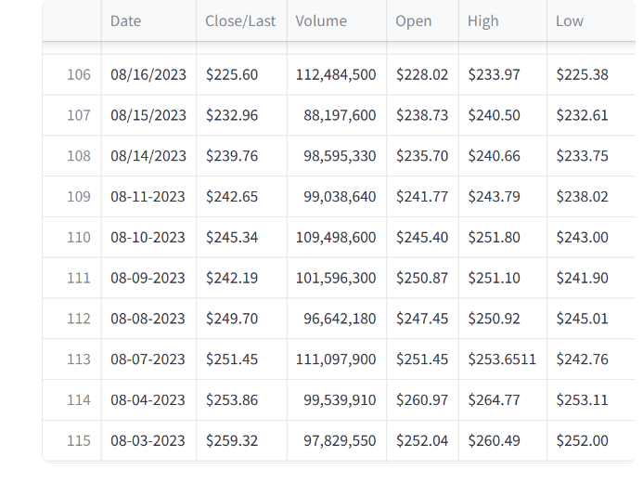
Tesla stock price prediction
Dataset of Tesla having stock details for last 10 years.
Size of dataset in rows and columns: (2517,6)

Slide 8
03 EDA

Slide 9
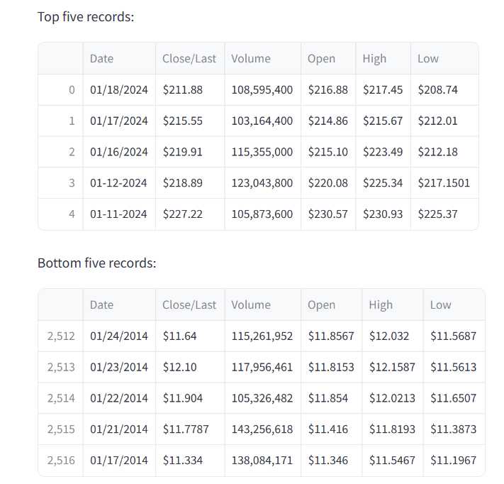
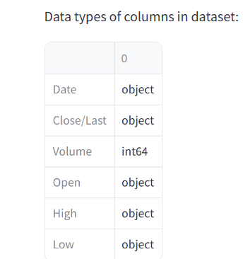

Slide 10
Inferences drawn:
Tesla stock prices downloaded from official website of NASDAQ.
2. Columns present in the dataset are Date, Close/Last, Volume, Open, High and Low.
3. Recent 10 years stock prices data.
4. Time format of Date column is MM/DD/YYYY and needs to be converted to datetime format.
5. Stock prices are in $ (Dollars).
6. Close/Last column needs to renamed to Close for convenience.
7. Currency data values decimals are inconsistent and needs to be standardized. 8. Dtypes of price features needs to be converted.

Slide 11

A PICTURE IS WORTH A
THOUSAND WORDS

Slide 12
04 Data Visualization

Slide 13
Data visualization
Data visualization is the graphical representation of information and data.
By using visual elements like charts, graphs, and maps ,and other visual tools.
Data visualization tools provide an accessible way to see and understand trends, outliers, and patterns in data .
The purpose of data visualization is to help drive informed decision-making and to add colorful meaning to an otherwise bland database.

Slide 14
Benefits of Data Visualization
Stock Price Prediction using machine learning helps in the future values of a company's stocks. Predicting stock prices helps in significant profits.
Moving average, linear regression, Auto ARIMA, and LSTM (Long Short Term Memory) are some of the most common Deep Learning algorithms used to predict stock prices.
Some of the indicators that predict stock prices help traders and investors trends, momentum, and potential points in stock prices.

Slide 15
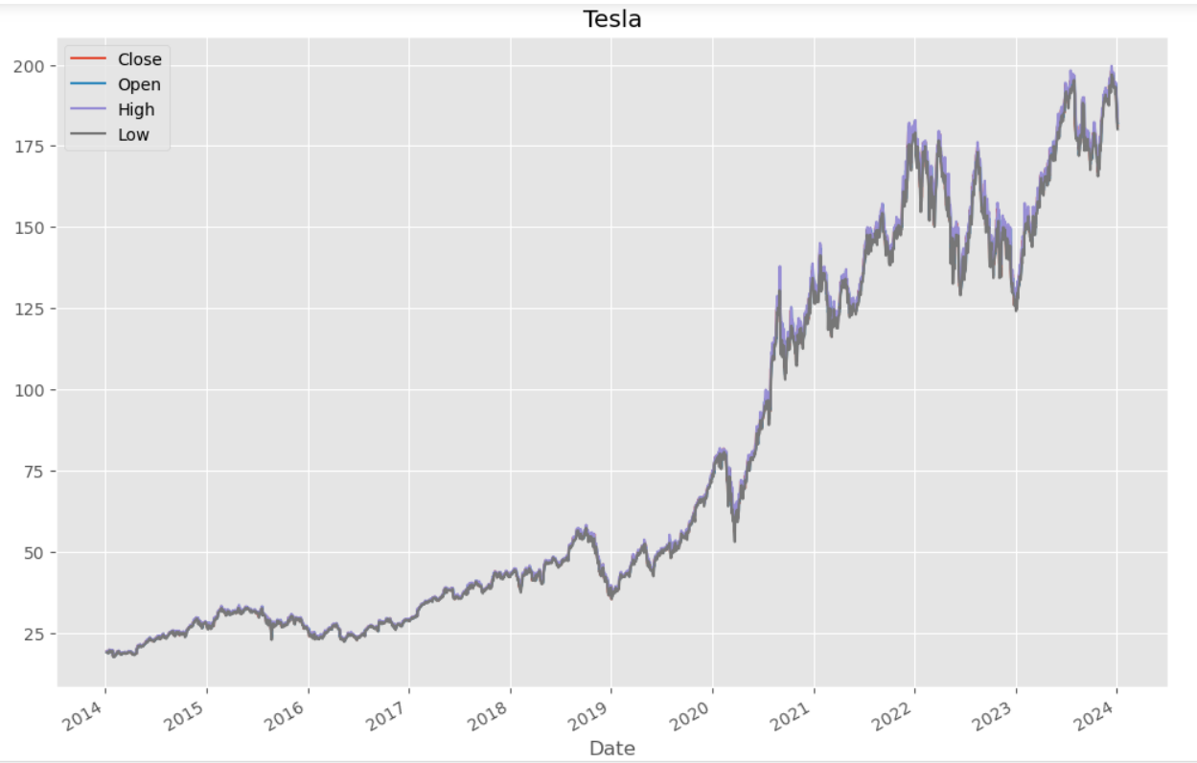
Time plot of whole dataset

Slide 16
Observations
Line plot of 'Close', 'Open', 'High', 'Low' features shows that their behaviour is same.
Volume plot shows more noise ie outliers presence.
Above plots are unclear and doesn't give much information of any feature.
Close price is more sacred in stock market and it referred as benchmark price for stock performance. Also, it gives more information about market sentiments. Hence, Only close price is used to visualize in upcoming analysis.

Slide 17
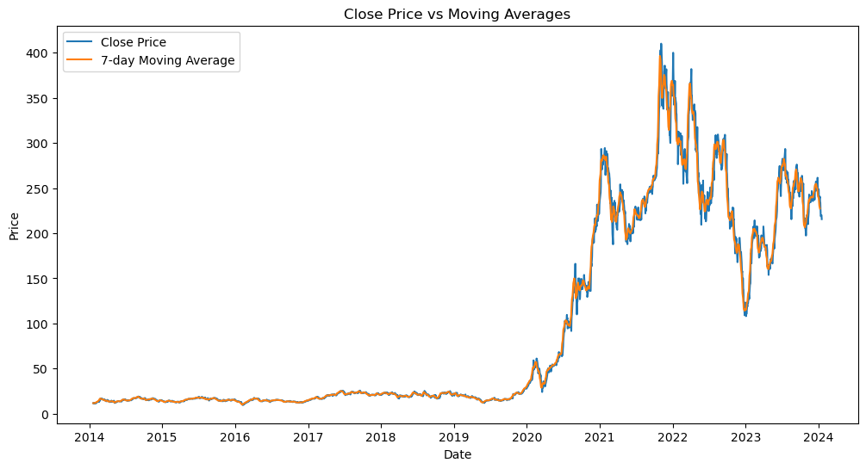
Observation:
Graph of moving average shows that there is no stationarity in the dataset.
Graph is smooth and less noisy.

Slide 18
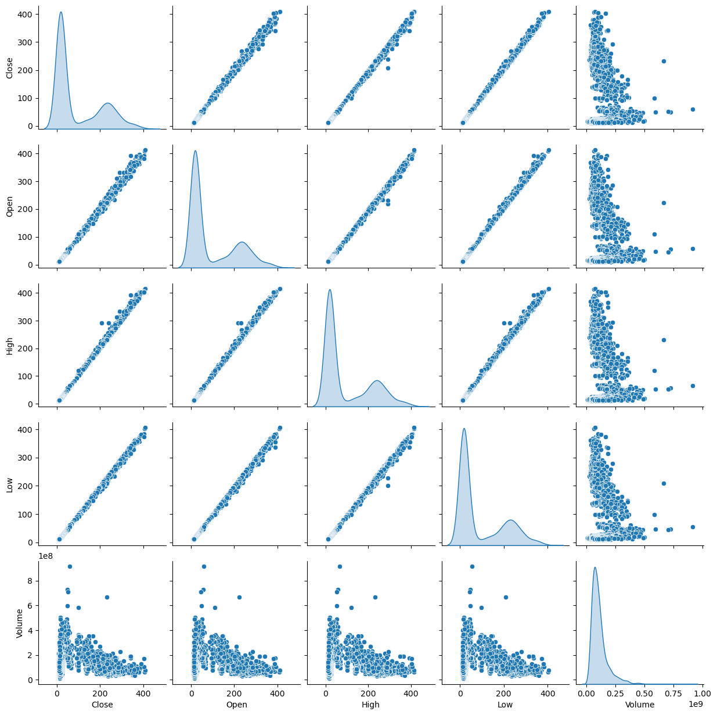
Pairplot
It can be observed from above pair plot that distribution of columns is not normal and all features are right skewed (+ve skewness).
Kernel density plots helps to visualize the distribution of values in the time series. Also, helps in identifying outliers and understanding the data's central tendencies.
Volume feature has high kurtosis value and confirms presence of outliers. Where as, other features have low kurtosis and have low / nil outliers.

Slide 19
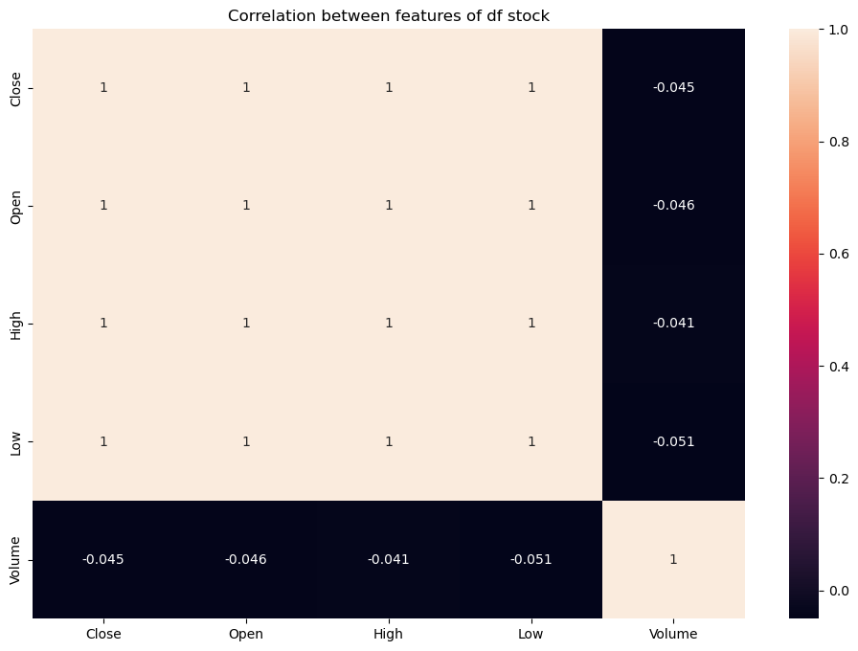
Correlation Heatmap
Observation:
Features 'Close', 'Open', 'High' and 'Low' are linearly correlated to each other. Therefore, nature of all the columns will be same.
Volume has very low correlation with other columns.

Slide 20
05 Model selection

Slide 21
Why Model selection matters?
Impact on Predictive Performance:
Different models may have varying levels of predictive accuracy on a given dataset.
The choice of the right model can significantly impact the model's ability to make accurate predictions on new, unseen data
Computational Efficiency: Crucial for applications with large datasets or real-time processing
Generalization to New Data: The ultimate goal of a predictive model is to generalize well to new, unseen data

Slide 22
Recommended Models For Time Series
Base Model
ARIMA
SARIMAX
Prophet
LSTM

Slide 23
Criteria for Models Selection
Criteria | ARIMA | SARIMAX | Prophet | LSTM
Ease of Use | Easy | Moderate | Easy | Complex
Handling Seasonality | Manual | Built-in | Built-in | Needs Tuning
Training Time | Fast | Moderate to Slow | Fast | Slow
Robustness to Noise | Sensitive | Sensitive | Moderate | Moderate
Parameter Tuning | Manual | Manual | Automatic | Manual
Real-time Predictions | Suitable | Moderate Suitability | Suitable | Limited Suitability
Use Cases | Univariate | Multivariate | Seasonal Forecasting | Sequential Patterns

Slide 24
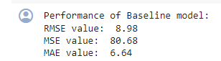
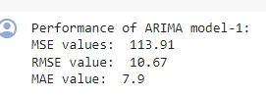
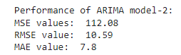
Models Evaluation Matrix
Base model
Arima
Sarimax

Slide 25
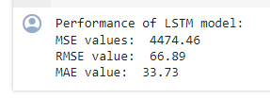
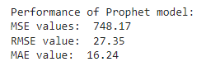
Models Evaluation Matrix
LSTM Model
Prophet Model

Slide 26
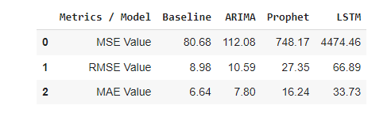
Conclusion : Best Model

Slide 27
06 Deployment

Slide 28
Link for Streamlit
https://p335-stock-price-predictiong.streamlit.app/

Slide 29
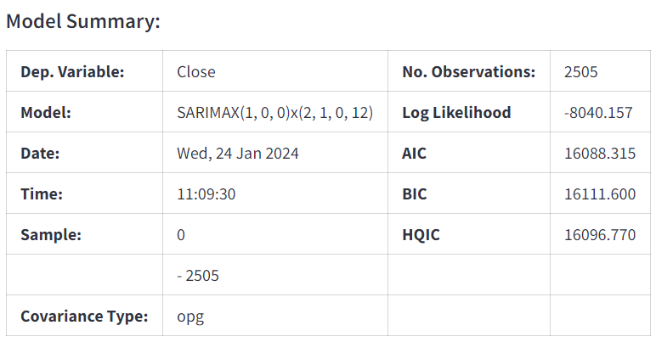
ARIMA time series prediction model

Slide 30
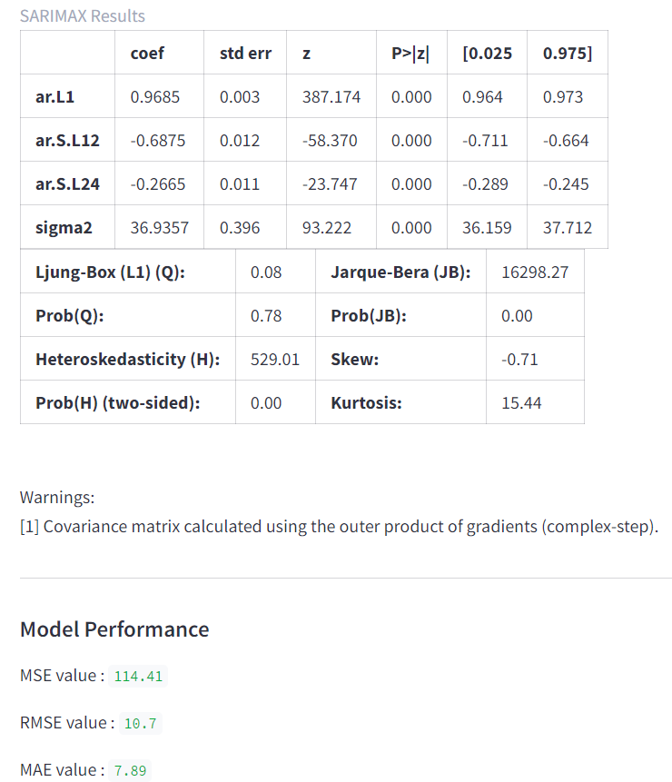

Slide 31
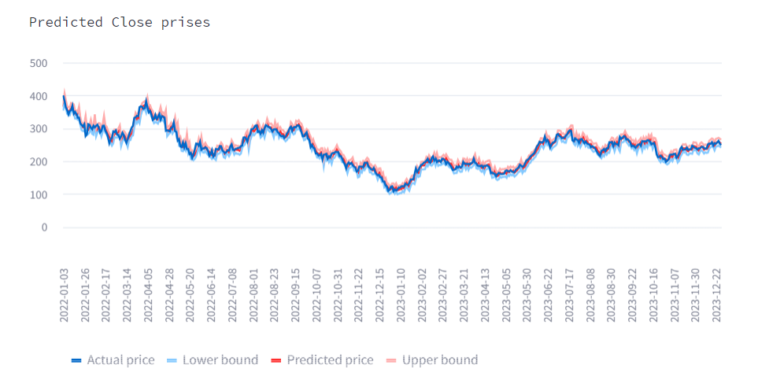
Visualization of results

Slide 32
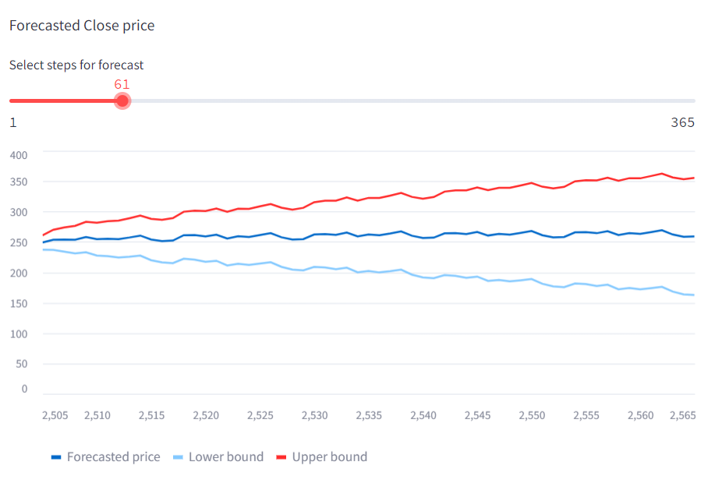

Slide 33
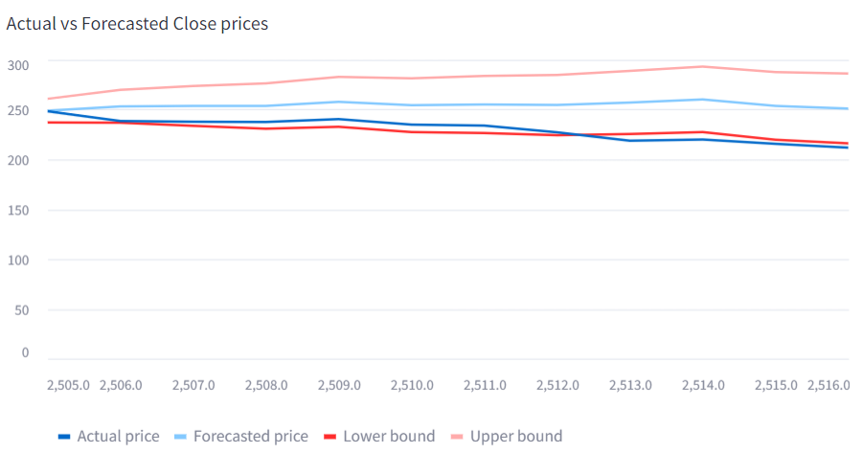

Slide 34
THANKS
Do you have any questions?

